Slide 1
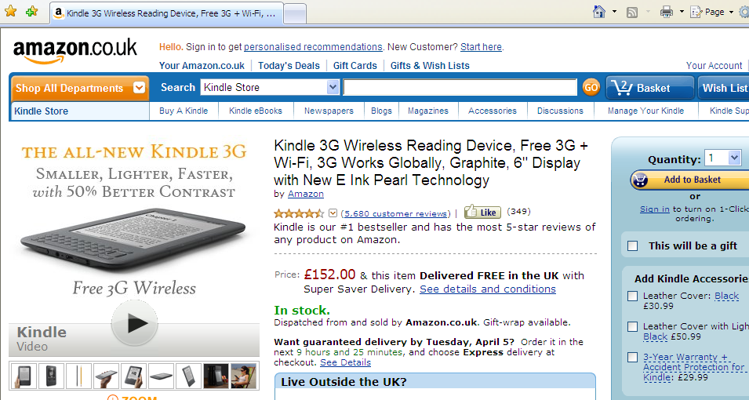
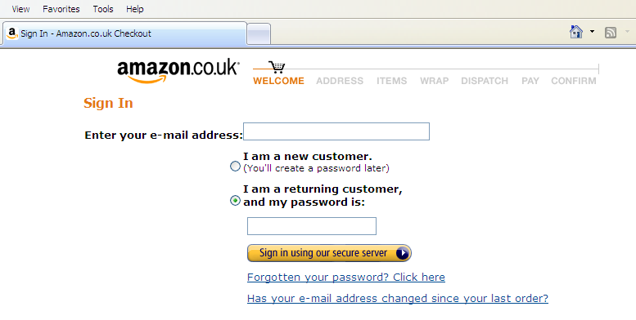
Why do web designers need databases?
Ecommerce is an important use.
Any other uses for databases?

Slide 2
Databases are for:
http://www.hscripts.com/tutorials/mysql/select-pattern.php
  storing data
  Data mining – finding data once it has been stored
Data is stored in a table.
Student_ID | Name | Grade | TelNo
157 | David | B | 01123
232 | Michael | C | 01345
514 | Jack | C | 01135
301 | Anne | A | 01531
200 | Anne | C | 01432

Slide 3
Finding data in a list
Pattern Matching
Student_ID | Name | Grade | TelNo
157 | David | B | 01123
232 | Michael | C | 01345
514 | Jack | C | 01135
301 | Anne | A | 01531
200 | Anne | C | 01432
Search for:
Name: David
Name: Anne
Grade: C
Student_ID | Name | Grade | TelNo
157 | David | B | 01123
Student_ID | Name | Grade | TelNo
301 | Anne | A | 01531
200 | Anne | C | 01432
Student_ID | Name | Grade | TelNo
232 | Michael | C | 01345
514 | Jack | C | 01135
200 | Anne | C | 01432

Slide 4
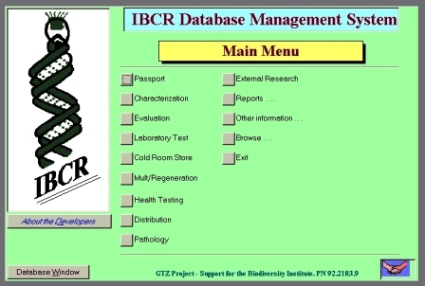

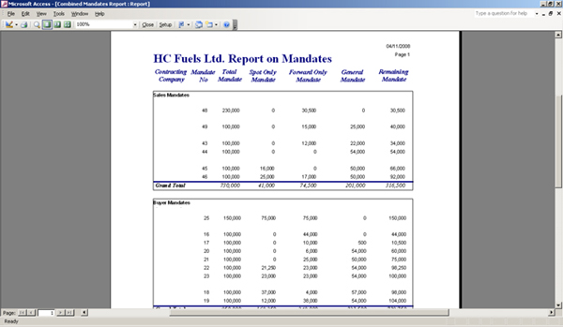
Designing a database
Databases need IT professionals to design them.
Managers and office workers use databases that IT professionals have designed.
Database designers create the searches, reports and interface that other workers use.

